Slide 1

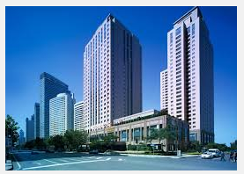
Team Voltron: Project HotelAccommodation
Project purpose, Project scope, Class diagrams, Additional Information
Members:
Mihail Aleksiev
Nikolay Genov
Stamo Petkov
Svetlin Panov
Todor Miroleskov

Slide 2

Table of Contents
Project Purpose
Project Scope
Class Diagrams
Additional Information

Slide 3
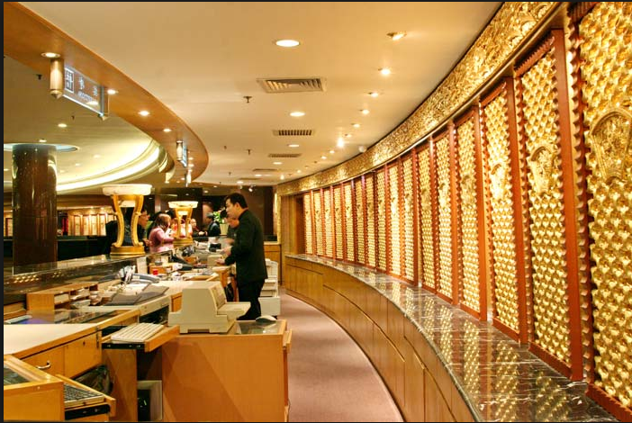
Project purpose
Simulate real world objects and their behavior
Create object and their relationships
Add functionality which represent real events
Living facility with day to day activities
Hotel manager hire personal
Receptionist check-in and check-out guests.
Maid clean rooms

Slide 4

Project Scope
22 Classes
3 Interfaces
3 Enumerations
2 Events
1 Structure

Slide 5
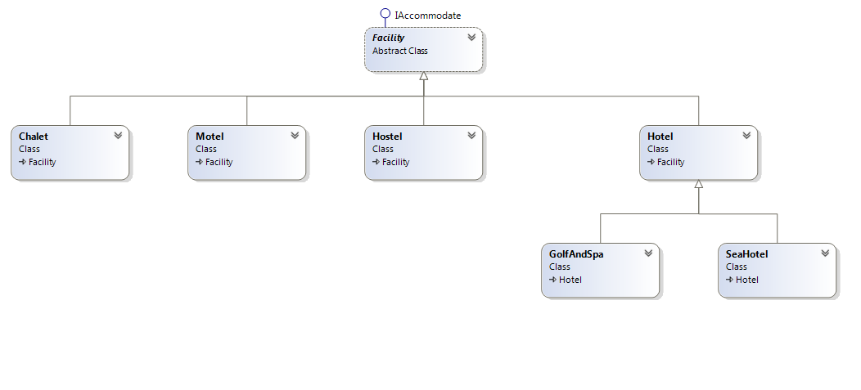
Class Diagram Facility(1)

Slide 6
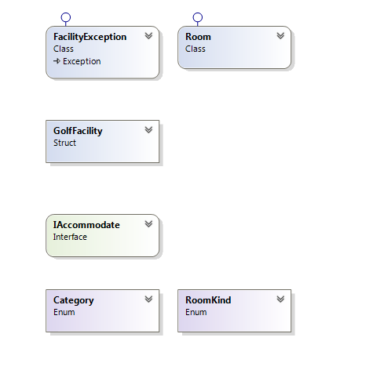
Class Diagram Facility(2)

Slide 7
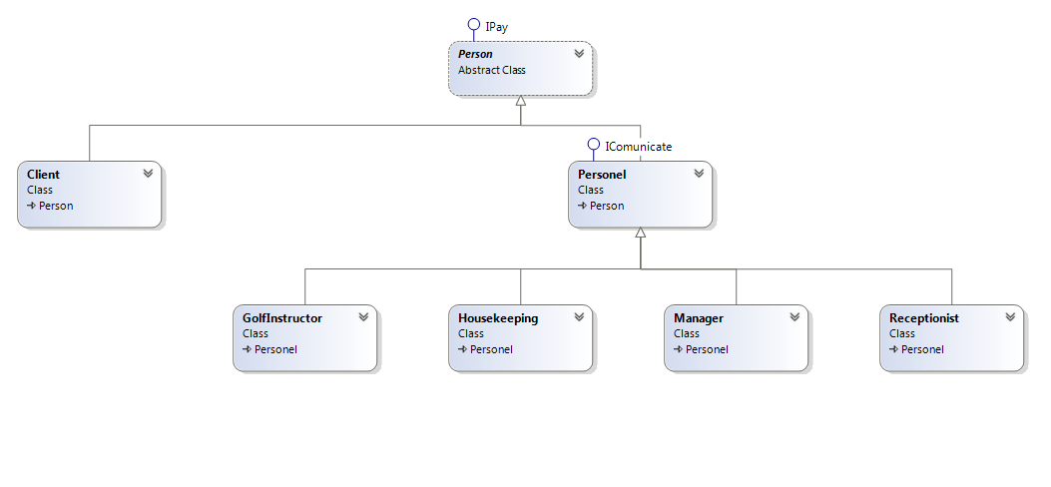
Class Diagram Person(1)

Slide 8
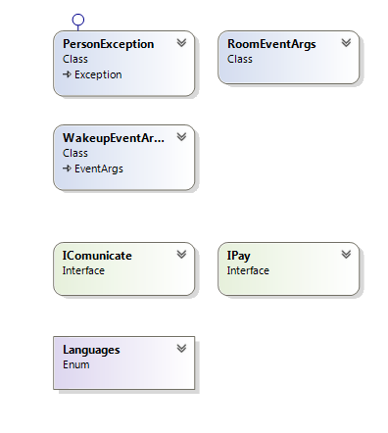
Class Diagram Person(2)

Slide 9
Additional Information
Interesting Method
SayIt() –phrase in predefined base language and translates the phrase via Google Translate.
Design Patterns used:
Facade Design Pattern. – Creating objects.
Factory Method Design Pattern. – Provide simplified Interfaces
Composite Pattern. – Three structure, every element perform a task.
Observer Pattern. – Used for event subscription.

Slide 10

Any questions
Questions?

